Slide 1
Personal Fitness Application
Project Website:
https://personalfitnessapplication.000webhostapp.com/
Note: Preferred web browser is Google Chrome

Slide 2
Project Name: Personal Fitness Application
Project Purpose: The purpose of our fitness application is to provide the similar experience of
having fitness session at home instead of going to the gym. Should include all
fitness friendly options, user profile, videos tutorial, physical activity, and gym
nutritional program, calories count, personal trainer, third-party device
connectivity, user activity tracking, fitness target and geolocation.
Anticipated Completion : 10 December,2021.
Approved Budget: Up to $200,000
Key Participants:
Participant | Position | Primary responsibilities
Prabesh Dhakal | Project Manager | Supervise the project programmer and Analytics, apply pressure and incentives to complete the project on time, and conduct weekly field visits to assess progress.
Sanjib Bhujel | Programmer | Write and test code that allows computer application and software programs to function properly.
Mohan Subedi | Analytics | Manage and analyze the entire project and the operation.

Slide 3
System Scope Development
Personal Fitness Application
Problem description
Music can improve exercise and brain performance, but personal fitness apps can make exercise more efficient and easier. The COVID-19 pandemic situation has changed our way of life. To keep our body stable, proper exercise is essential. Personal training apps can provide you with coaching plans and exercises without having to leave home or hire someone at the gym yourself. Generally, they are more affordable and easier to obtain for those who wish to conduct structured, professionally designed exercises based on personal goals and needs. Owing to the lockdown and the increase in COVID-19 cases, all fitness clubs are not suitable for exercise. As the new coronavirus is spreading, people must be cautious about all possible exposures, including at the gym or fitness center. The virus does not spread through sweat (sweat), but many people touch items (barbells, dumbbells, treadmills, machines, etc.) that may pose risks. People are getting sick and facing difficulties of sharing gym equipment’s which has hindered the people safety and concentration on doing proper workout. Hence, in this project, we plan to build a personal fitness application with all the functions and benefits to improve our muscle strength, enhance our endurance, and protect us from the virus.
Anticipated Business Benefits
The main benefit of this personal fitness app is that we can experience regular exercise and physical activity, which will promote strong muscles and bones. More immediate benefits include the following:
Easily monitor your diet and progress.
Provide free fitness tips and healthy habits.
Provide a personal health coach and keep you motivated.

Slide 4
Helps in improving breathing, cardiovascular health, and overall health.
Staying active can also help you maintain a healthy weight and help reduce your risk of type2 diabetes, heart diseases, and certain cancers.
Get free exercise advice, set achievable goals, exercise at home without wearing a mask, relax and stay away from the virus.
When traveling or visiting relatives’ homes, bring your own gym or yoga studio anytime, anywhere without worrying about paying the coach.
System Capabilities
To obtain the business benefits, register above, following capabilities should be included in Personal Fitness Application.
Its users must be able to customize diet plans and workout schedule.
Push notification systems and reminders with social sharing options for a better personalized experience.
Geolocation and gamification options will increase confidence and performance.
Maximized wearable device integration
Multi-device synchronization tracking target tracker and the sleep tracker can improve each exercise, making more captivating and enthusiastic.
Use online consultation and chat and deep heart monitoring to reduce people’s confusion.
Developed easy, reliable, and fast user-friendly system to keep motivation alive and high.

Slide 5
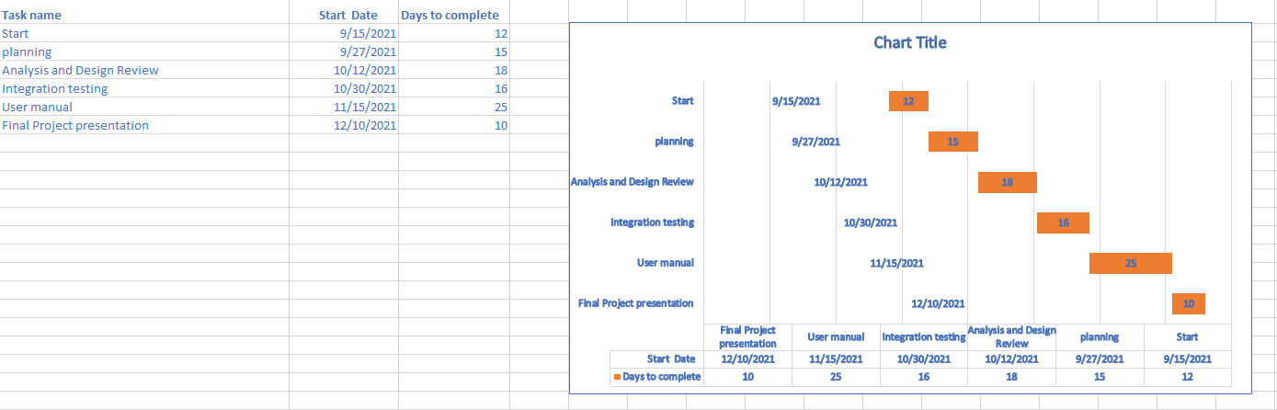
Project Schedule

Slide 6
ER Diagram
An Entity Relationship (ER) Diagram is a type of flowchart that illustrates how “entities” such as people, objects or concepts relate to each other within a system.
ER diagrams are based on three basic concepts: entities, attributes and relationships. They are used to sketch out the design of a database.
An entity can be place, person, object, event or a concept, which stores data in the database.
Entities are represented by means of their properties, called attributes. All attributes have values.
The association among entities is called a relationship

Slide 7
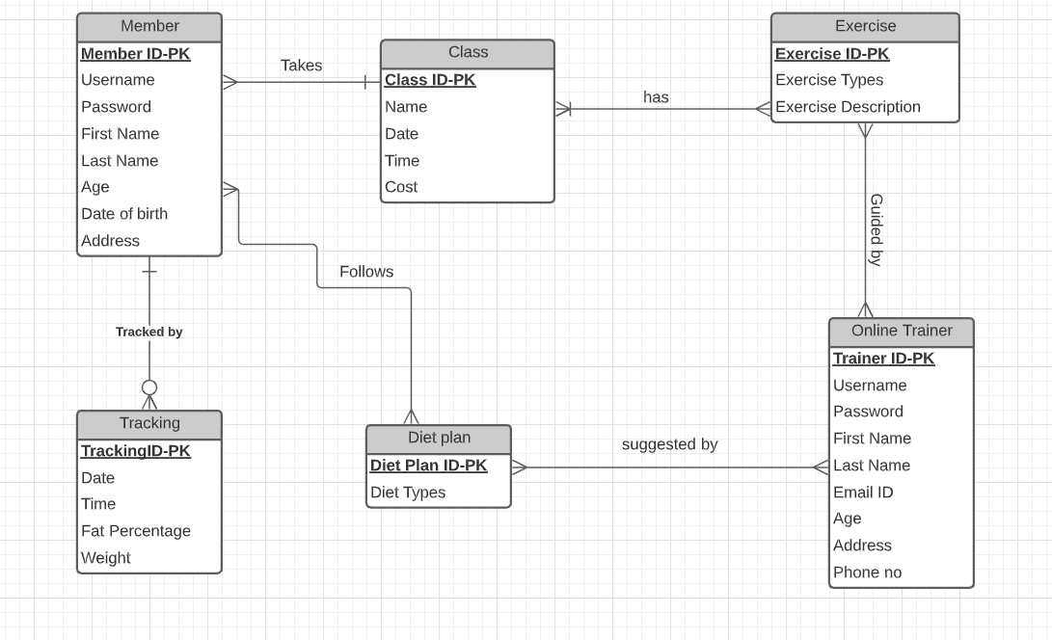
ERD For Personal Fitness Application:

Slide 8
ER Diagram
By Prabesh Dhakal

Slide 9
Sematic Network
A semantic network is a graphic representation for representing knowledge in patterns of interconnected nodes
Semantic networks are mainly used for representing data, revealing structure, supporting conceptual edition and supporting navigation
Semantic nets consist of nodes, links and link labels.
In these network diagrams , nodes appear in form of circles or ellipses or even rectangles which represents objects such as physical objects, concepts or situations.
Links appear as arrows to express the relationships between objects
Link labels specify relations

Slide 10
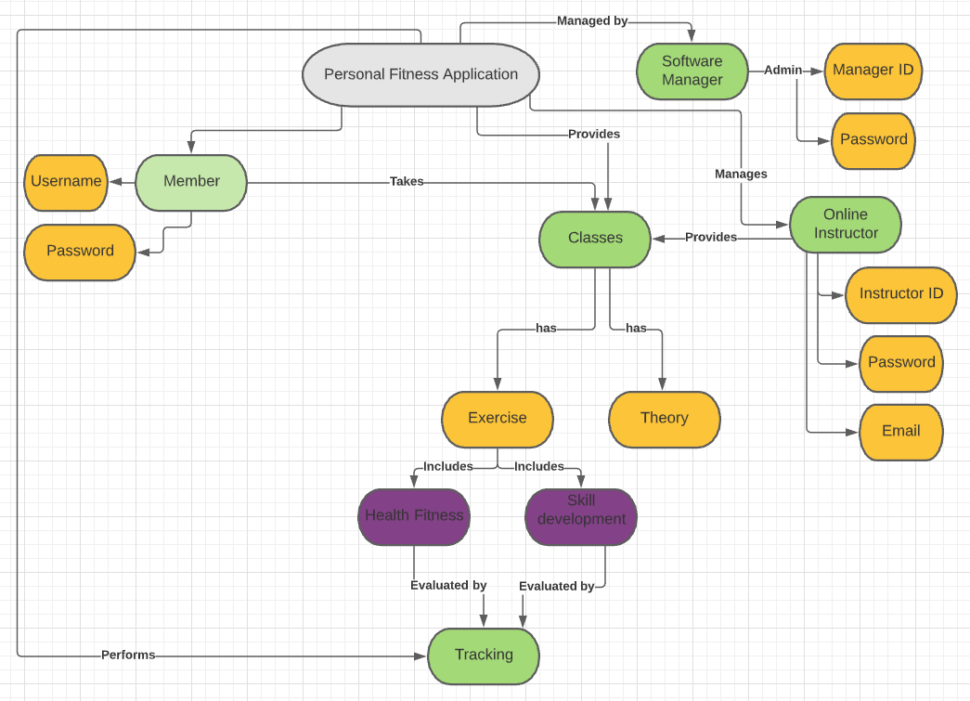
Semantic Network Diagram

Slide 11
Classes of Personal Fitness Application Class Diagram
User Information Class: Manage all operations of user information
App User Class: Manage all operations of application
Calculator Class: Manage all operations of calories burned
Exercise Information Class: Manage all operations of exercise performed
Goal Class: Manage all operations of target earned
Routine Class: Manage all operations of schedule exercises
Rest Time Class: Manage all resting time for relaxation
New App User class: Manage all operations of new user applicants

Slide 12
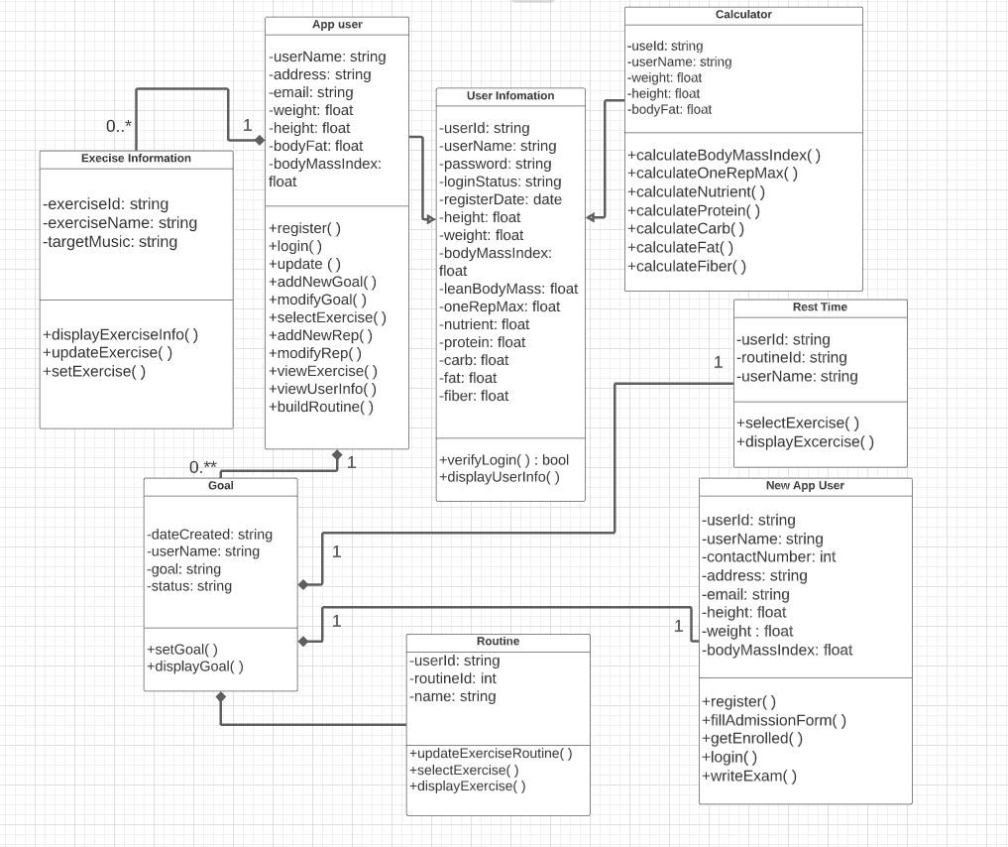
Domain Model Class Diagram

Slide 13
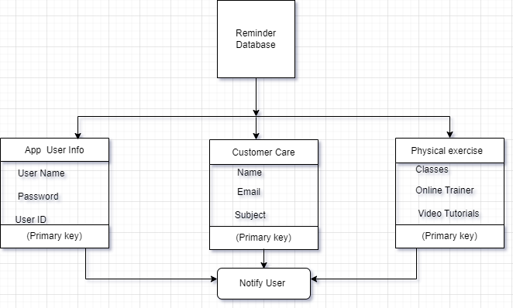
Domain Class Diagram: Database

Slide 14
What is State Machine Diagram?
A state machine diagram is a type of behavioral diagram in the Unified Modeling Language that shows transitions between various objects.
A state machine diagram is a graph consisting of: States (simple states or composite states) and State transitions connecting the states
UML state machine" can refer to two kinds of state machines: behavioral state machines and protocol state machines.

Slide 15
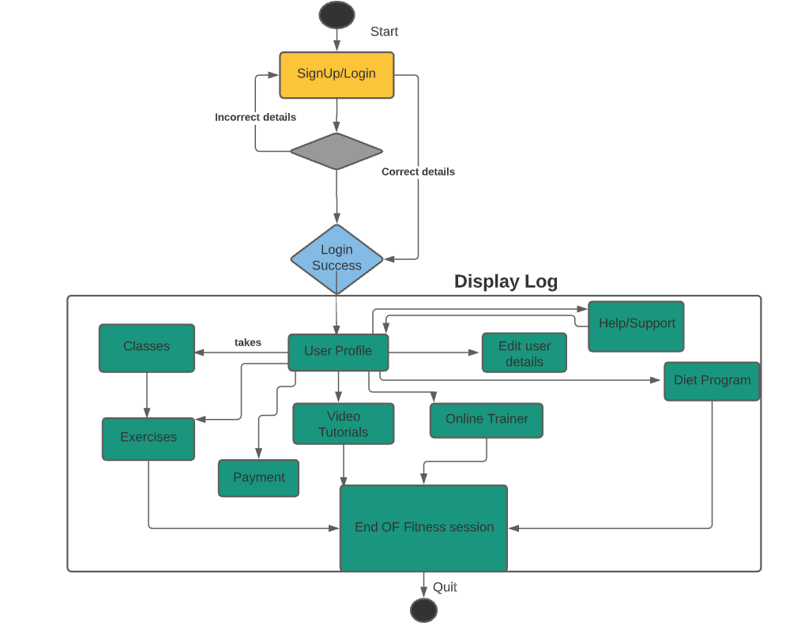
State Machine Diagram

Slide 16
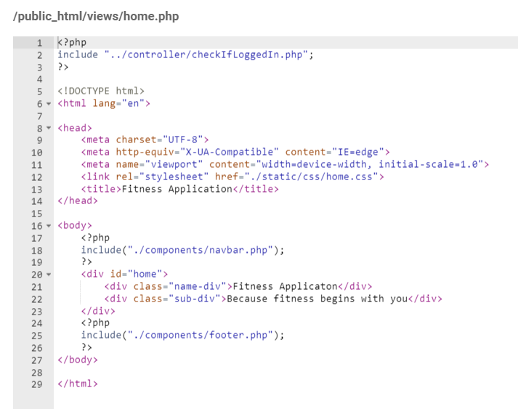
Sample code for Personal Fitness Application

Slide 17
State Machine Diagram
By Sanjib Bhujel

Slide 18
The relationships between the User and the use cases of Personal Fitness Application:
Member: Use cases of member are login and logout application, update profile, change account password, choose membership type, choose trainer, search best option and transfer email/information.
Software Manager: Use cases of software manager are login and logout application, update profile, change account password, maintain user account, display user logs, query booking and transfer email/information.
Trainer: Use cases of trainer are login and logout application, update profile, change account password, monitor schedule, create training sessions, reporting member info and transfer email/information.
System: Use cases of system are login and logout application, update profile, change account password, get payment, provide renewal information, register new members and transfer email/information.

Slide 19
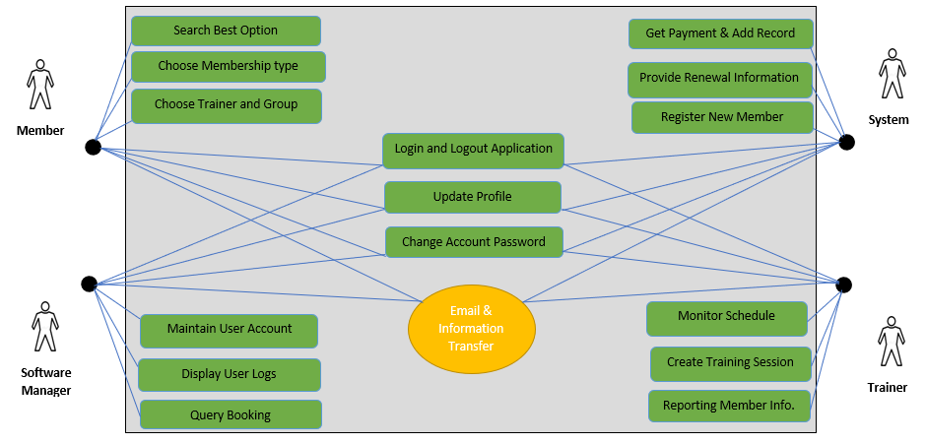
Use Case Diagram For Personal Fitness Application

Slide 20
Login Activity diagram of Personal Fitness Application:
Below is the login activity diagram of Personal Fitness Application, which shows the flow of login and registration activity, where user will be able to login using the username and password.
After login user can get all the features of Personal Fitness Application, contact or help, edit personal details, classes, exercise and diet plan, user’s performance tracking, and payment.
The diagram below helps to demonstrate how the login page works for personal fitness application. The various objects in the application helps to develop a routine, accountability and motivation, finding proper techniques, relationship of fitness & nutrition and personalized program for all user.

Slide 21
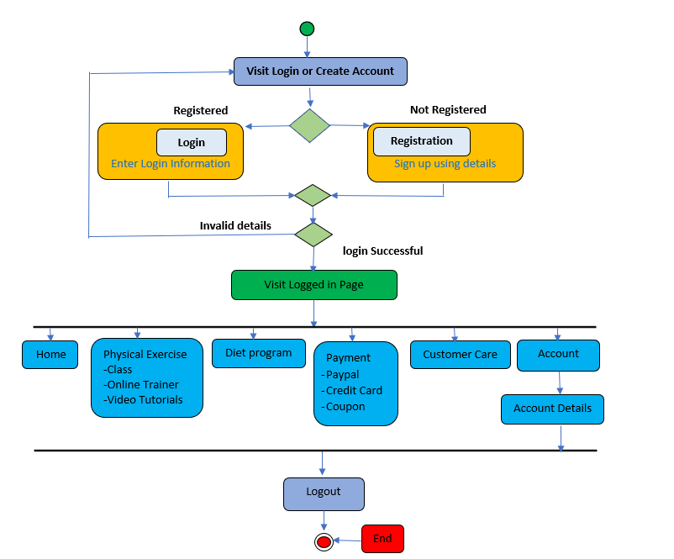
Activity Diagram of Personal Fitness Application:

Slide 22
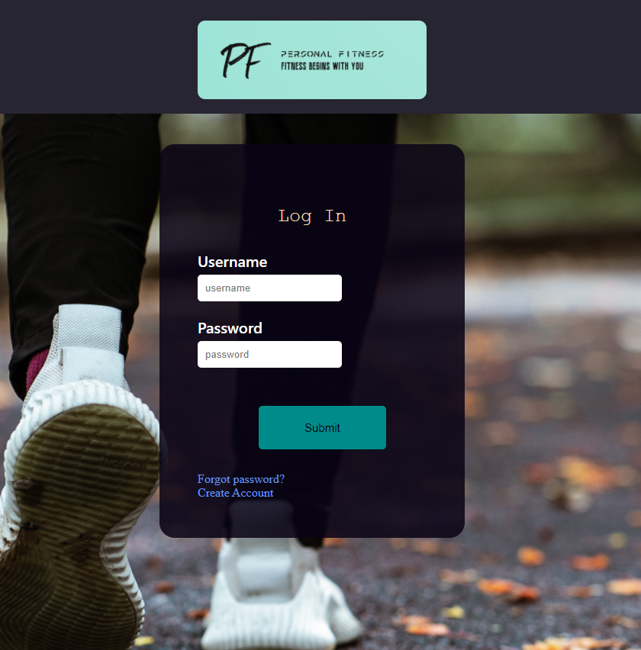
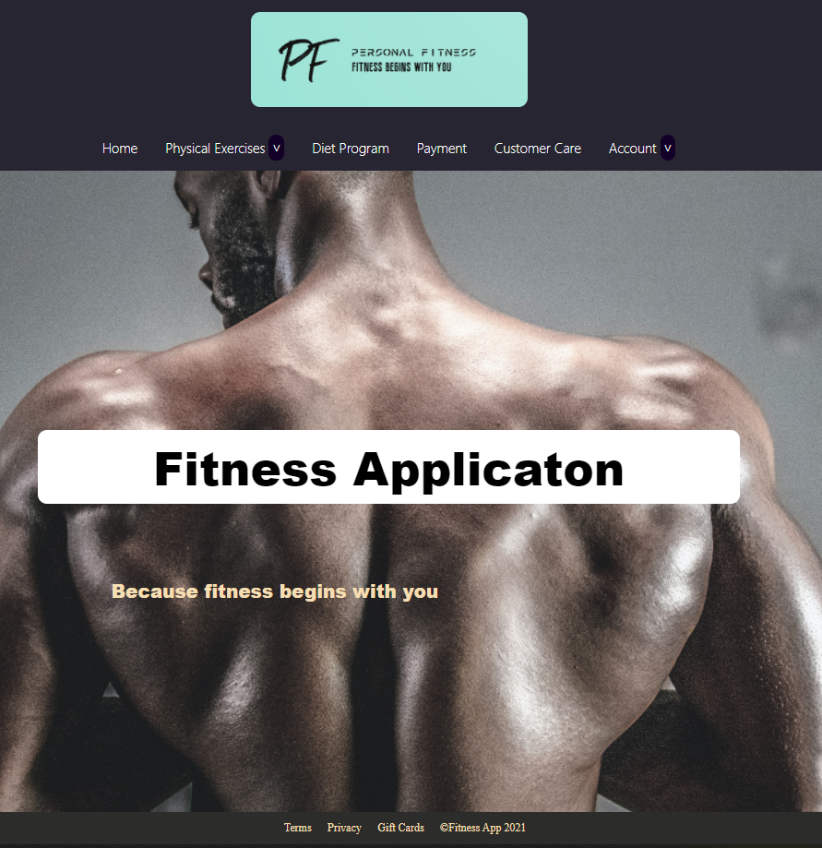
Main Page & Logged in Page
After Login

Slide 23
System Sequence Diagram Description
Below is the login sequence diagram of Personal Fitness Application, Where admin will be able to login in their account using their credentials. After login user can follow all the activity on Fitness Categories, Contact or Support , Classes, Exercise & Diet Plan, User’s Performance tracking , and User's payments.
The diagram below helps demonstrate how the login page works in a Personal Fitness Application. The various objects of the application and facility page interact over the course of the sequence, and user will not be able to access this page without verifying their identity.

Slide 24
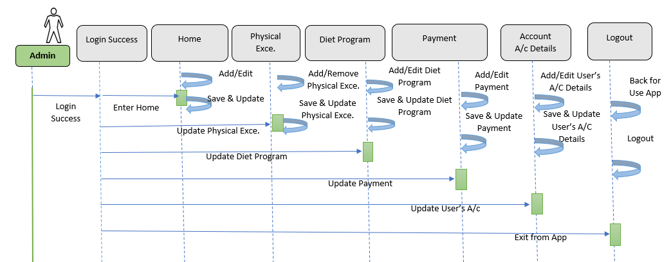
System Sequence Diagram of Personal Fitness Application:

Slide 25

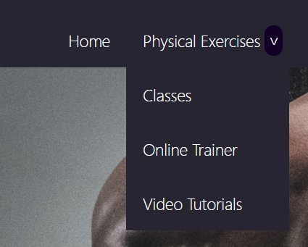
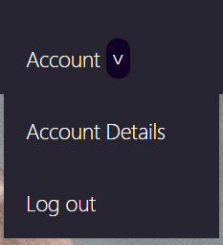

Slide 26
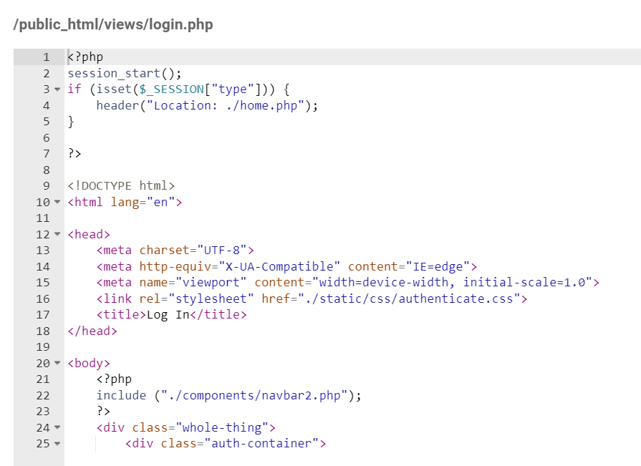
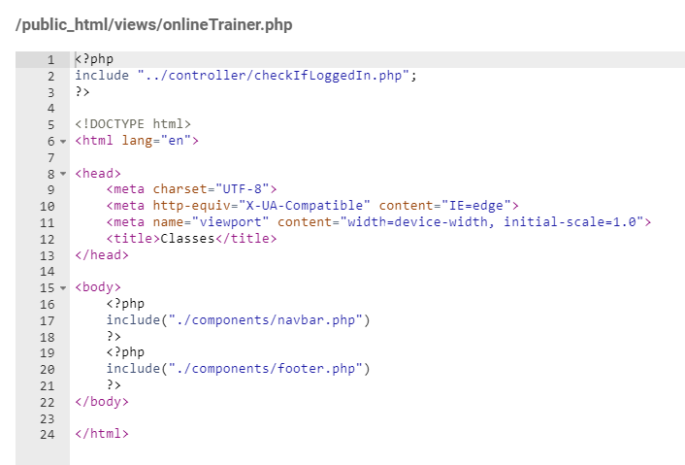
Sample code for Personal Fitness Application

Slide 27
Activity & System Sequence Diagram
By Mohan Subedi

Slide 28
THANK YOU!

